Slide 1
F28DM Database Management Systems Overview
Phil Bartie
Email: phil.bartie@hw.ac.uk Office: EM G.29

Slide 2

Materials released under CC-BY License
You are free to:
Share — copy and redistribute the material in any medium or format
Adapt — remix, transform, and build upon the material for any purpose, even commercially.
The licensor cannot revoke these freedoms as long as you follow the license terms.
Under the following terms:
Attribution — You must give appropriate credit, provide a link to the license, and indicate if changes were made. You may do so in any reasonable manner, but not in any way that suggests the licensor endorses you or your use.

Slide 3

Lecturers: Edinburgh
Phil Bartie
Phil.Bartie@hw.ac.uk
Office: EM G.29
Office hour: appt by email
Alasdair Gray
A.J.G.Gray@hw.ac.uk
Office: EM 1.39
Office hour: appt by email

Slide 4
Topics in this lecture
Introduction to the course
Topics
Timing
Assessment
Resources

Slide 5


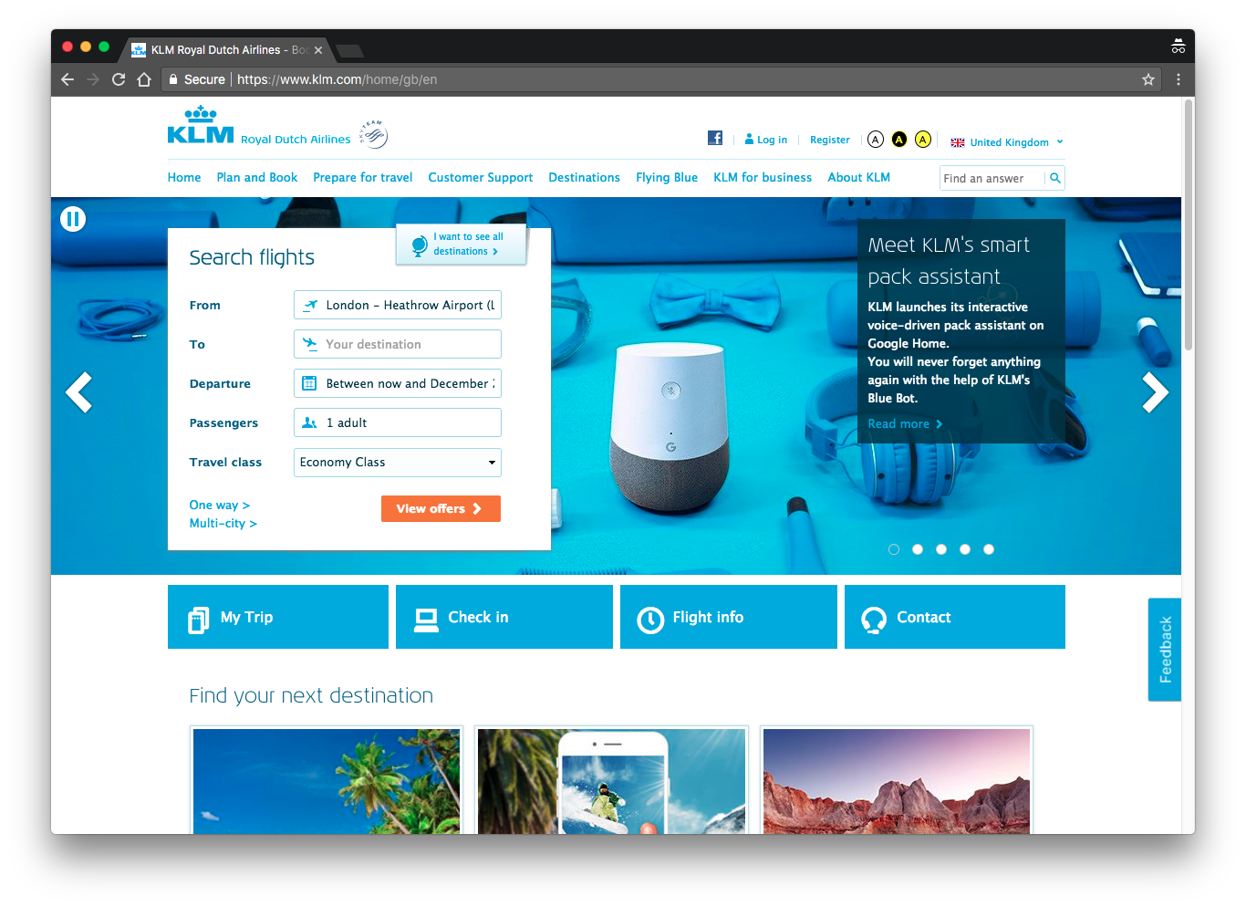
Course Aim
To familiarise students with the principles of database management systems, to enable them to design and implement databases for specific applications and to integrate databases with software applications.

Slide 6
Database Management System

Slide 7
Syllabus: Database Design
Data requirements
Entity relationship diagrams
Relational data model
Integrity constraints
Key constraints
Types
Integrity maintenance

Slide 8
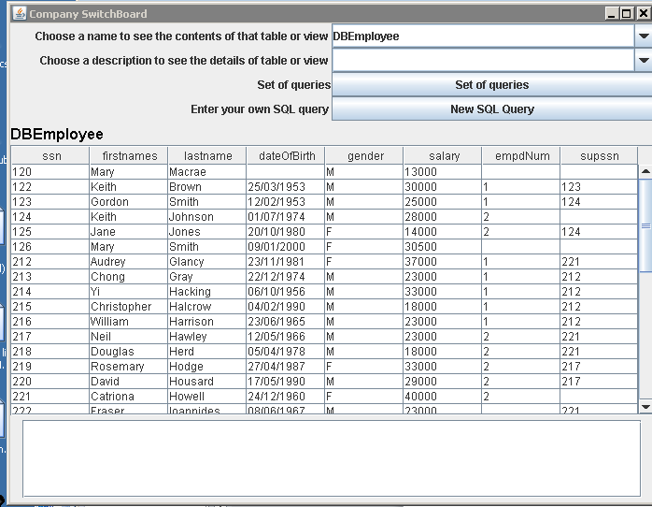
Syllabus: Relational Queries
SQL
Boolean combinations of queries
Aggregation
Duplicate elimination
Nested queries
Negation
Views
Insertions
Deletions
Updates
Command level interfaces
Integration with programming application
Notes:
CRUD – create, read, update, delete.

Slide 9
Syllabus: Query Execution and Optimisation
Data storage principles
File organisation
Indexing
Indexes in commercial DBMSs
Relational algebra
Query execution plans
Cost estimation of plans
Interpretation of plans
Physical database design

Slide 10
Syllabus: Concurrency
Transactions
Schedules
Serialisability
Concurrency control protocols
Locking
Two-phase-locking
Time stamp based concurrency control
https://www.linkedin.com/pulse/what-acid-properties-database-aseem-jain/
Notes:
Concurrency can be defined as the ability for multiple processes to access or change shared data at the same time.
(e.g. Google DOCS permits concurrent editing)
Schedule − A chronological execution sequence of a transaction is called a schedule. A schedule can have many transactions in it, each comprising of a number of instructions/tasks.
A transaction scheduleis serializable if its outcome (e.g., the resulting database state) is equal to the outcome of its transactions executed serially, i.e. without overlapping in time.

Slide 11
Syllabus: Emerging Database Trends
Data warehousing
Distributed databases
Alternative database models
XML / JSON
NoSQL – Document
Object
Graph stores

Slide 12
Learning Outcomes: Subject Mastery
Broad knowledge and understanding of the concepts and formalisms of database design
Detailed knowledge of the building blocks and meaning of relational database queries
Critical understanding of the principles of query evaluation and concurrency control underlying database applications
Practice in the collection of data requirements and the design of conceptual database schemas
Evaluation of emerging database trends and ability to understand their benefits

Slide 13
Learning Outcomes: Personal Abilities
Practice in working on a development project in a small group (PDP)
Practice in defining the subject and scope of a development project (PDP)
Deconstructing a problem and synthesizing a solution (PDP)
Time management (PDP)

Slide 14
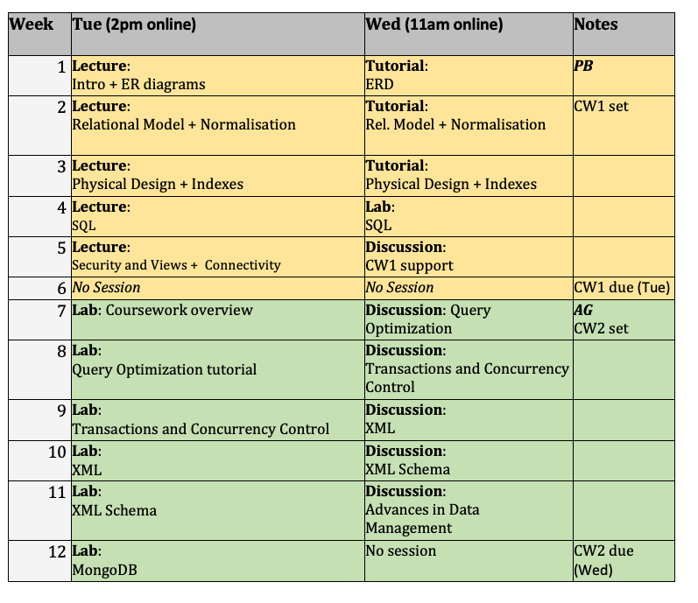
Timetable (Edinburgh)
Timetable on Vision -> Course Information
2 x 1 hour session online per week (Tue/Thu)
Mix of lecture, lab, tutorials, discussions
See timetable on Vision
Need writing materials for the labs / tutorials, there will be exercises.
Notes:
Demo Vision

Slide 15
Assessment
Exam
Coursework
70% examination (online?)
Past papers link on Vision
30% coursework
RDBMS
Design and implement RDBMS using MySQL [groups] – deadline week 6
XML – deadline week 12
Create an XML file [groups]
Define the structure
Data display on a web page.
15%
15%
https://superprofs.com/upsc/start-preparation-upsc-2017-exam/

Slide 16
Resources: Vision
Learning materials – thematically grouped
Lecture slides
Tutorial and lab exercises
Sample solutions
Additional web references
Linked In materials (e.g. videos)
Assessment
Coursework descriptors
Exam guidelines
Announcements
Also by email

Slide 17
Resources: Books
Relational Database Systems
Database Management Systems 2nd edition by Patricia Ward
Covers many essentials
Available digitally, or £2 per chapter.
Database Systems by Connolly and Begg
4th edition onwards
Very thick but comprehensive, far more than we need
XML
XML Data model and Syntax by Erik T Ray
Covers XML material
Notes:
Most relational database management systems textbooks would suffice
Can read some of Database Management Systems on Google Books.

Slide 18
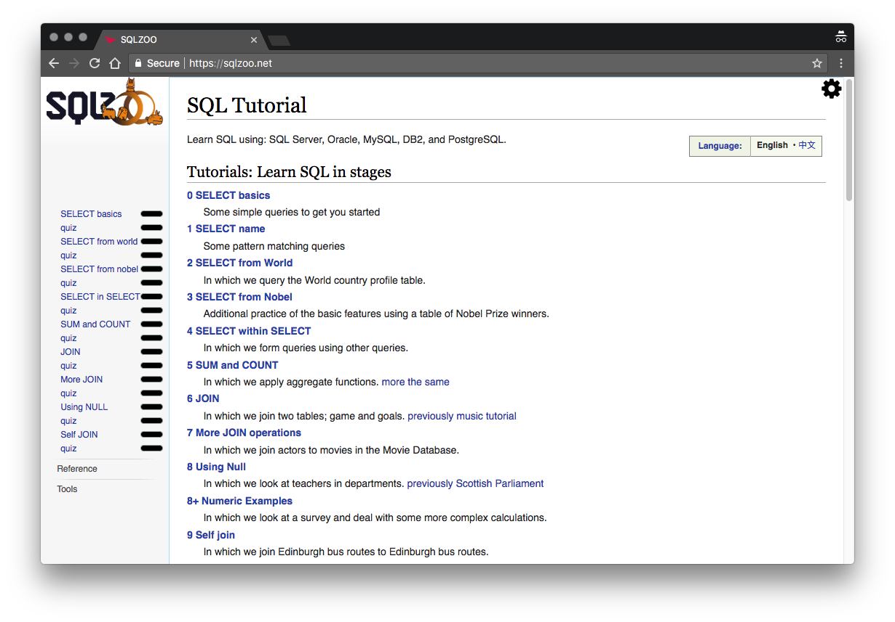
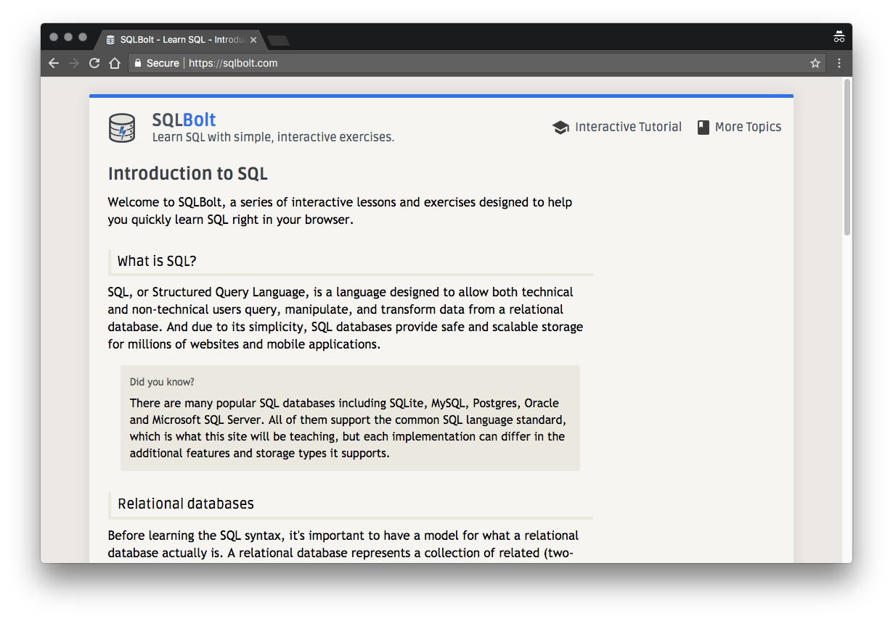
Resources: Web
Official MariaDB documentation https://mariadb.com/kb/en/documentation/
Version: 10.3.21
Web tutorials http://www.w3schools.com/
SQL: http://www.w3schools.com/sql/
XML: http://www.w3schools.com/xml/
XSLT: http://www.w3schools.com/xsl/

